Slide 1
10/24/18 Weekly Meeting Update
Testing is hard

Slide 2

General
Team leadership and position satisfaction poll results:
Everything is peachy
Oscillator: SiTime 32kHz ±3 ppm (~1.58 minute/year drift), 1.8 V, 4.5 µA typically
Arrived - smallest component I’ve ever seen
Memory: Can write to FRAM on MSP430
Notes:
1.58 = 3e-6*86400*365/60

Slide 3
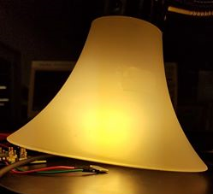
Power
Testing system:
Solar cell attached to energy harvester (EH)
Resistor in series with battery attached to EH
Measuring current through resistor
Writing MSP430 code to:
Sample analog voltage difference (i.e. current)
Save values to FRAM
Transmit via UART to laptop GUI
Mostly works?
Used oscilloscope to test constant current
We know 2 things:
Sunlight is luckily much different from lamplight
EH produces ~3 mA under direct lamplight
This seems screwy, must consult the elders
Input voltage might have been too low, try different panel
Confirmation of the circuit by someone who knows more than me would be nice
You can do it, buddy!

Slide 4
Power Data?
Sucessful charging at 1.8-3.0 mA (.001 V/15 seconds
5.4 mA (.001 V/ 5 seconds)
Solar Cells | Datasheet Voc (V) | Datasheet Isc (mA) | Lamp Voc (V) | Lamp Isc (mA)
KXOB22-12X1F | .63 | 44.6 | .477-.626 | 5.6
SLMD121H04L | 2.52 | 50 | 2.4 | 12.1
KXOB22-04X3F | 1.89 | 15 mA | 1.7 | 5.2
KXOB22-01X8F | 4.7 | 4.4 | 4.4 | 1.67

Slide 5
Communications
Preliminary current measurement w/ Feather board: max peak 39 mA
Preliminary current measurement w/ MSP430: max peak 13 mA
Both of the above measurements are with a phone connected to the bluefruit, but with no actual data being transmitted (however, there is some bluetooth beacon information being broadcast continually).
Preliminary range measurement: With a phone connected, the BLE connection would drop after walking from the electronics lab to the top of the stairs, or diagonally to the other corner of the basement.
Working on porting code from Arduino to C for use with MSP430
Moving slowly, will hopefully have this done and more exact testing done by this weekend

Slide 6
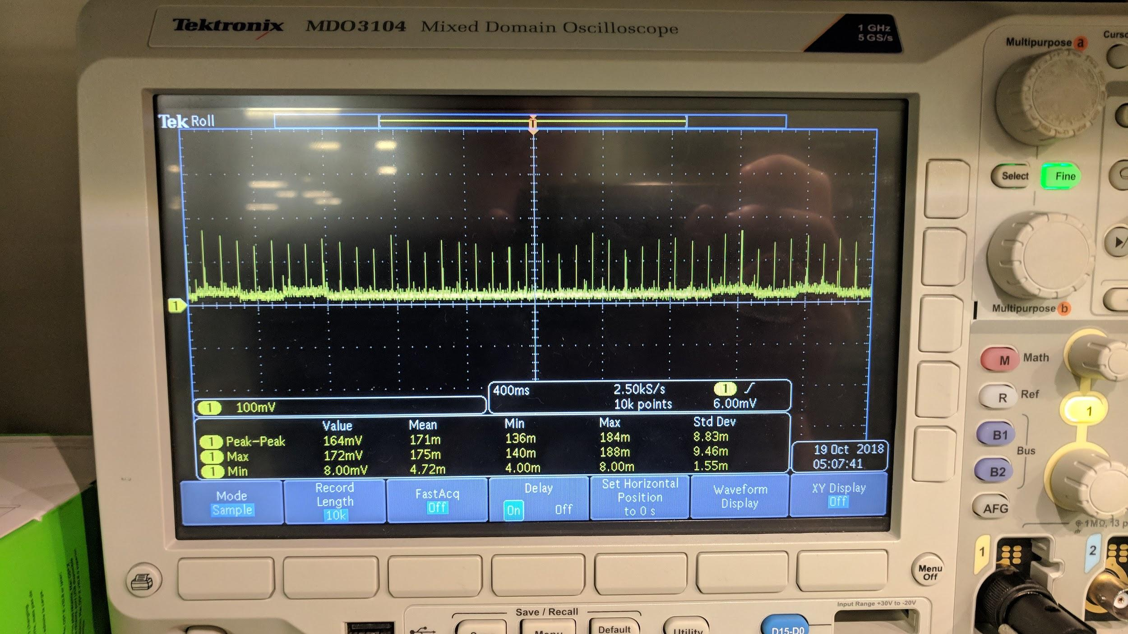
Communications
MSP430,
15 Ohm resistor

Slide 7
Sensor
Evaluation board for temperature/humidity sensor has arrived
Uses I2C
Working on unit test code
Arduino code provided by manufacturer, but need to convert/find/write I2C module for MSP430 (Code Composer Studio)
Ordered a PM2.5, PM10 particulate sensor
The documentation for this sensor is quite bad

